Slide 1
CERPRO - SIR/REP
010
05:00
Ives Tomita

Slide 2
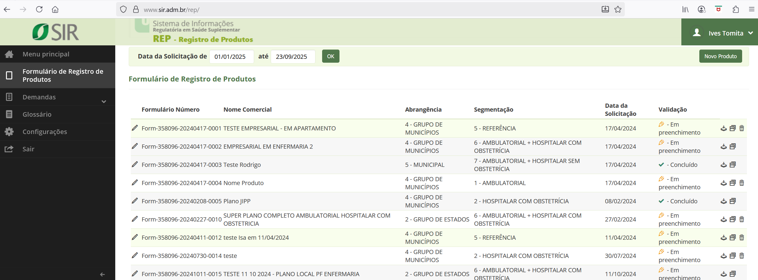
CERPRO – SIR/REP

Slide 3
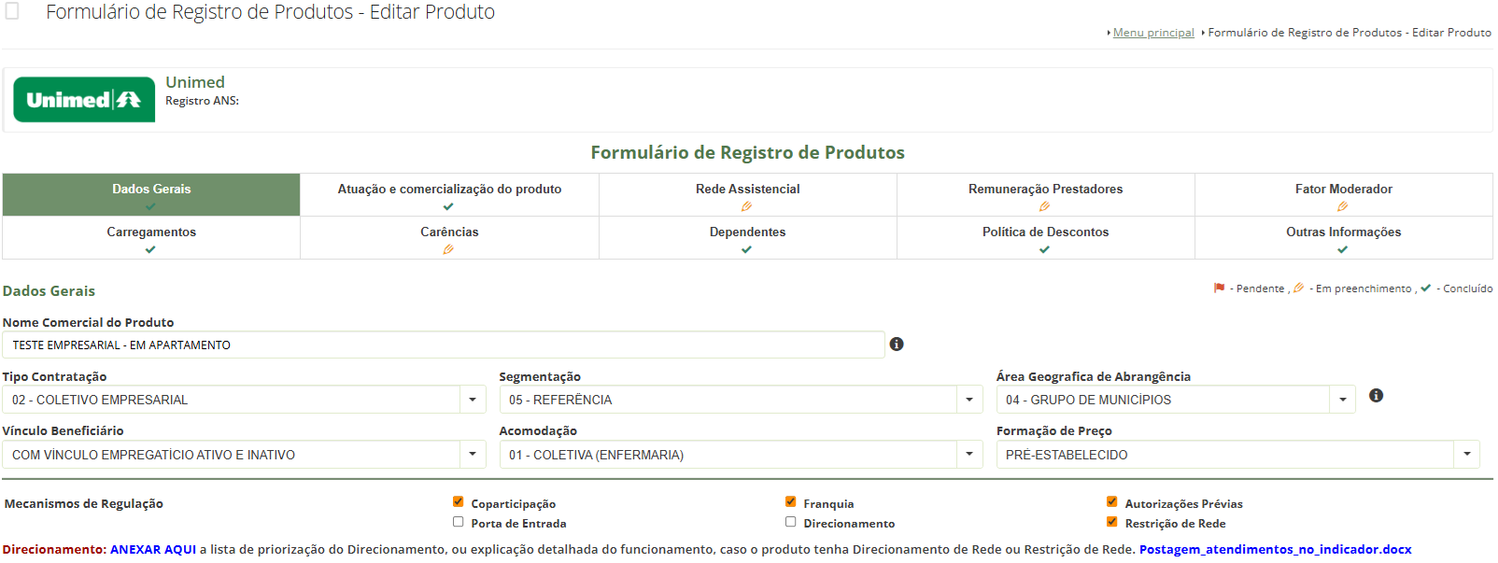
CERPRO – SIR/REP

Slide 4
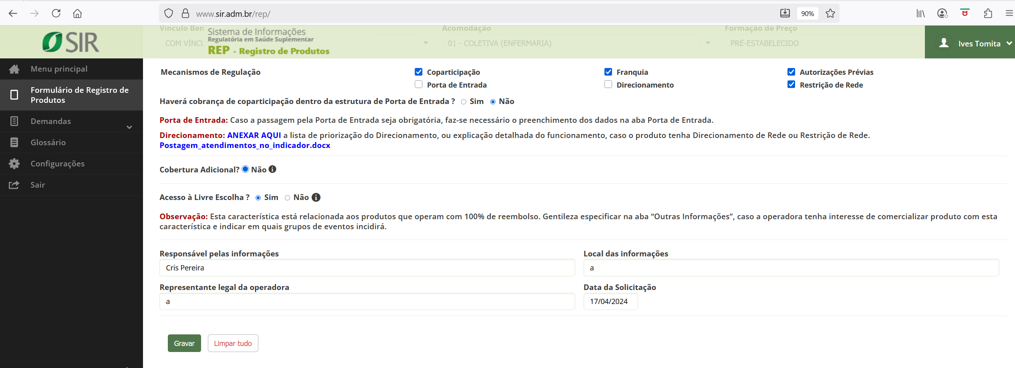
CERPRO – SIR/REP

Slide 5
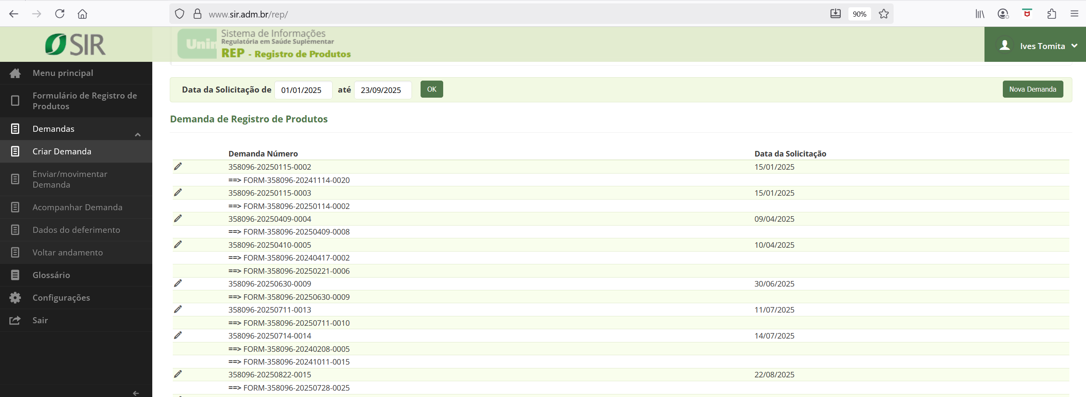
CERPRO – SIR/REP

Slide 6
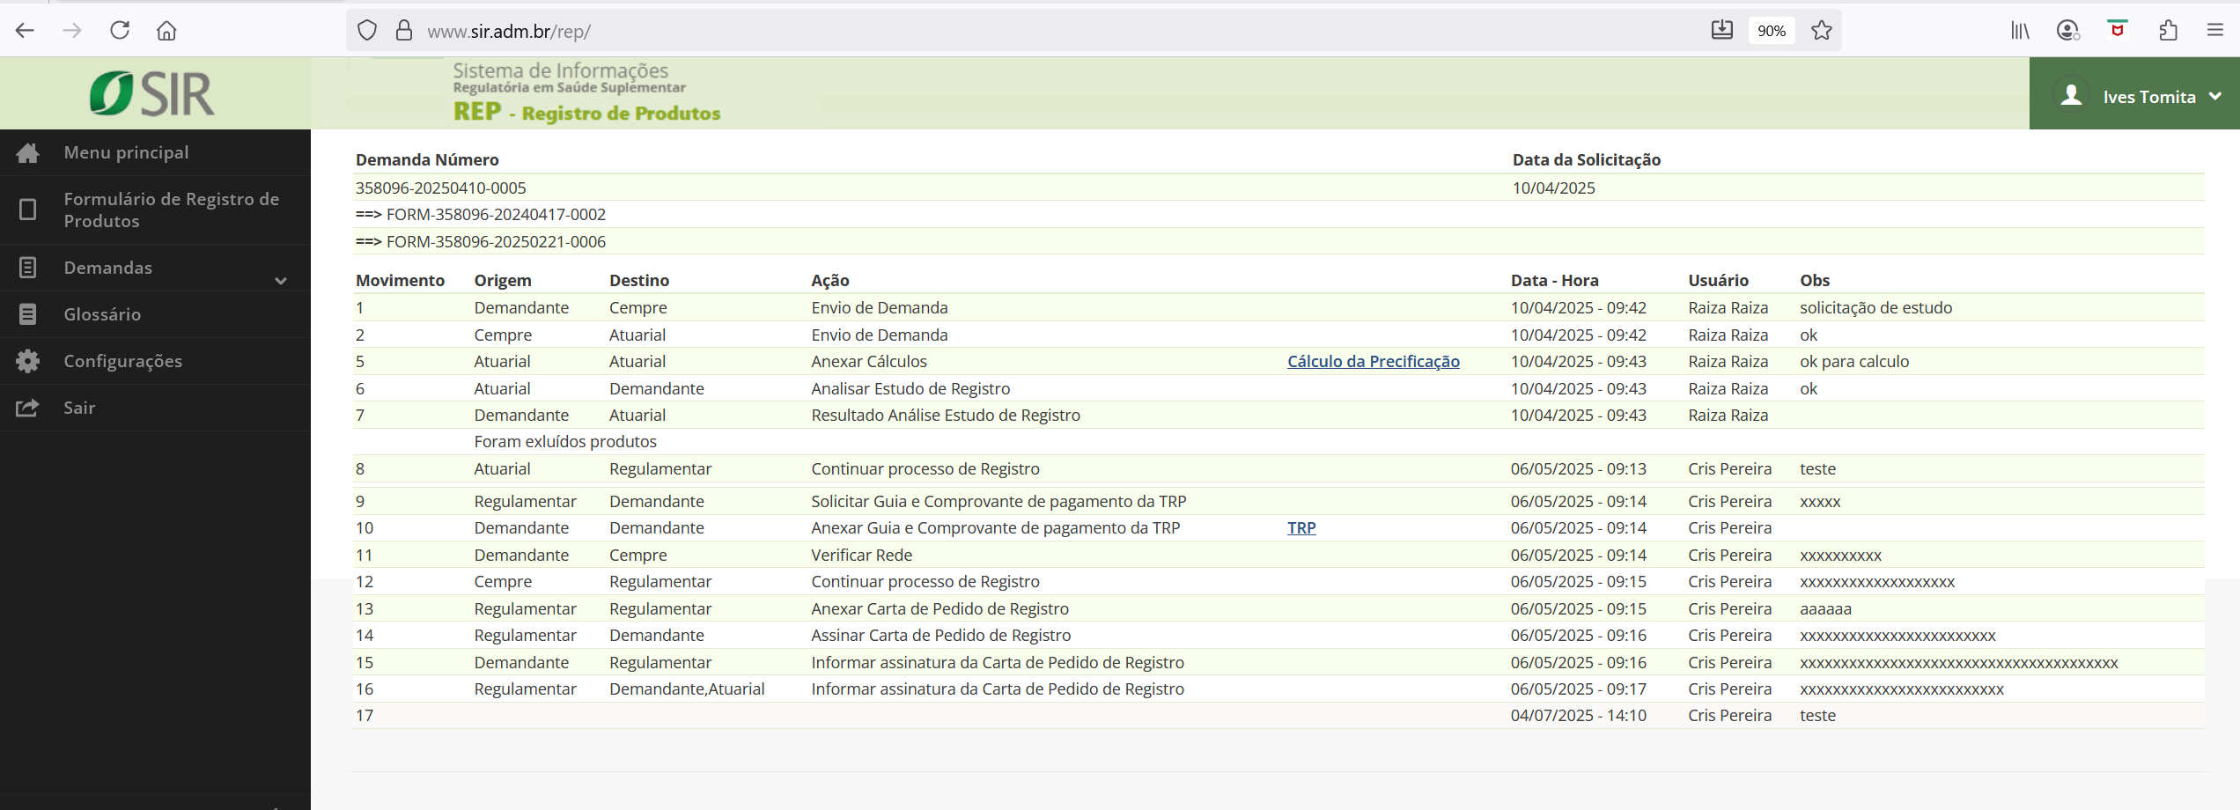
CERPRO – SIR/REP

Slide 7
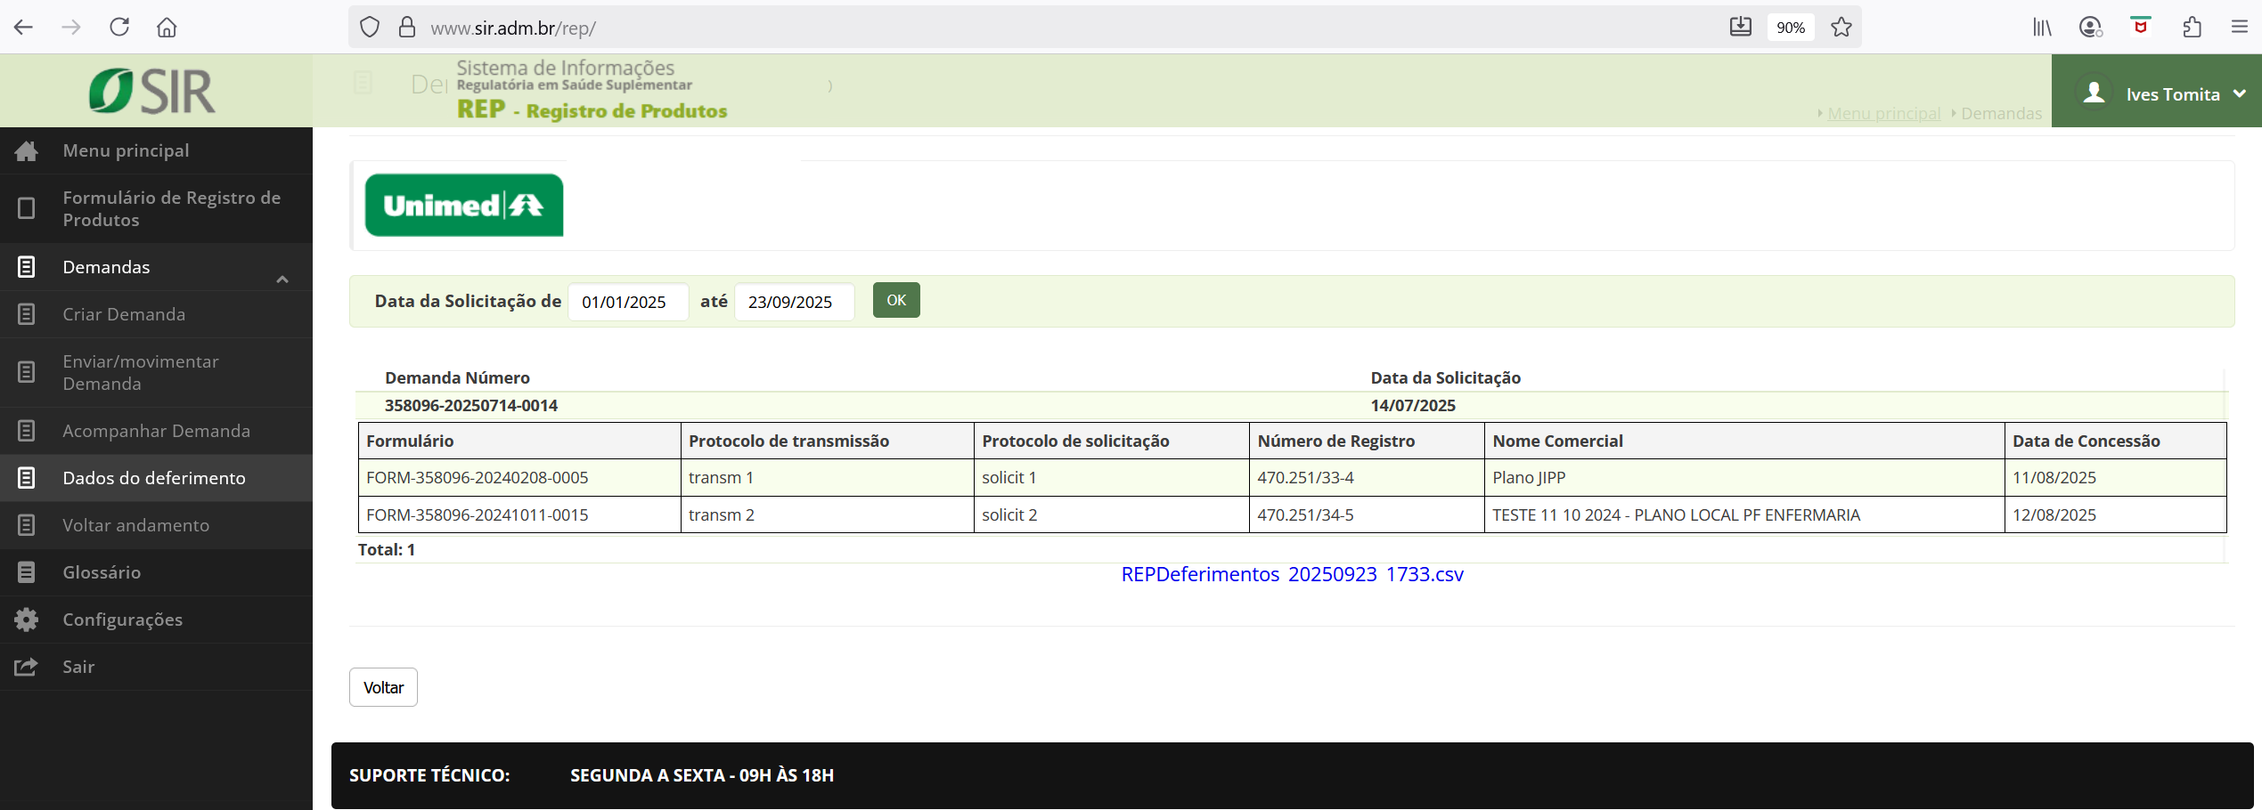
CERPRO – SIR/REP

Slide 8
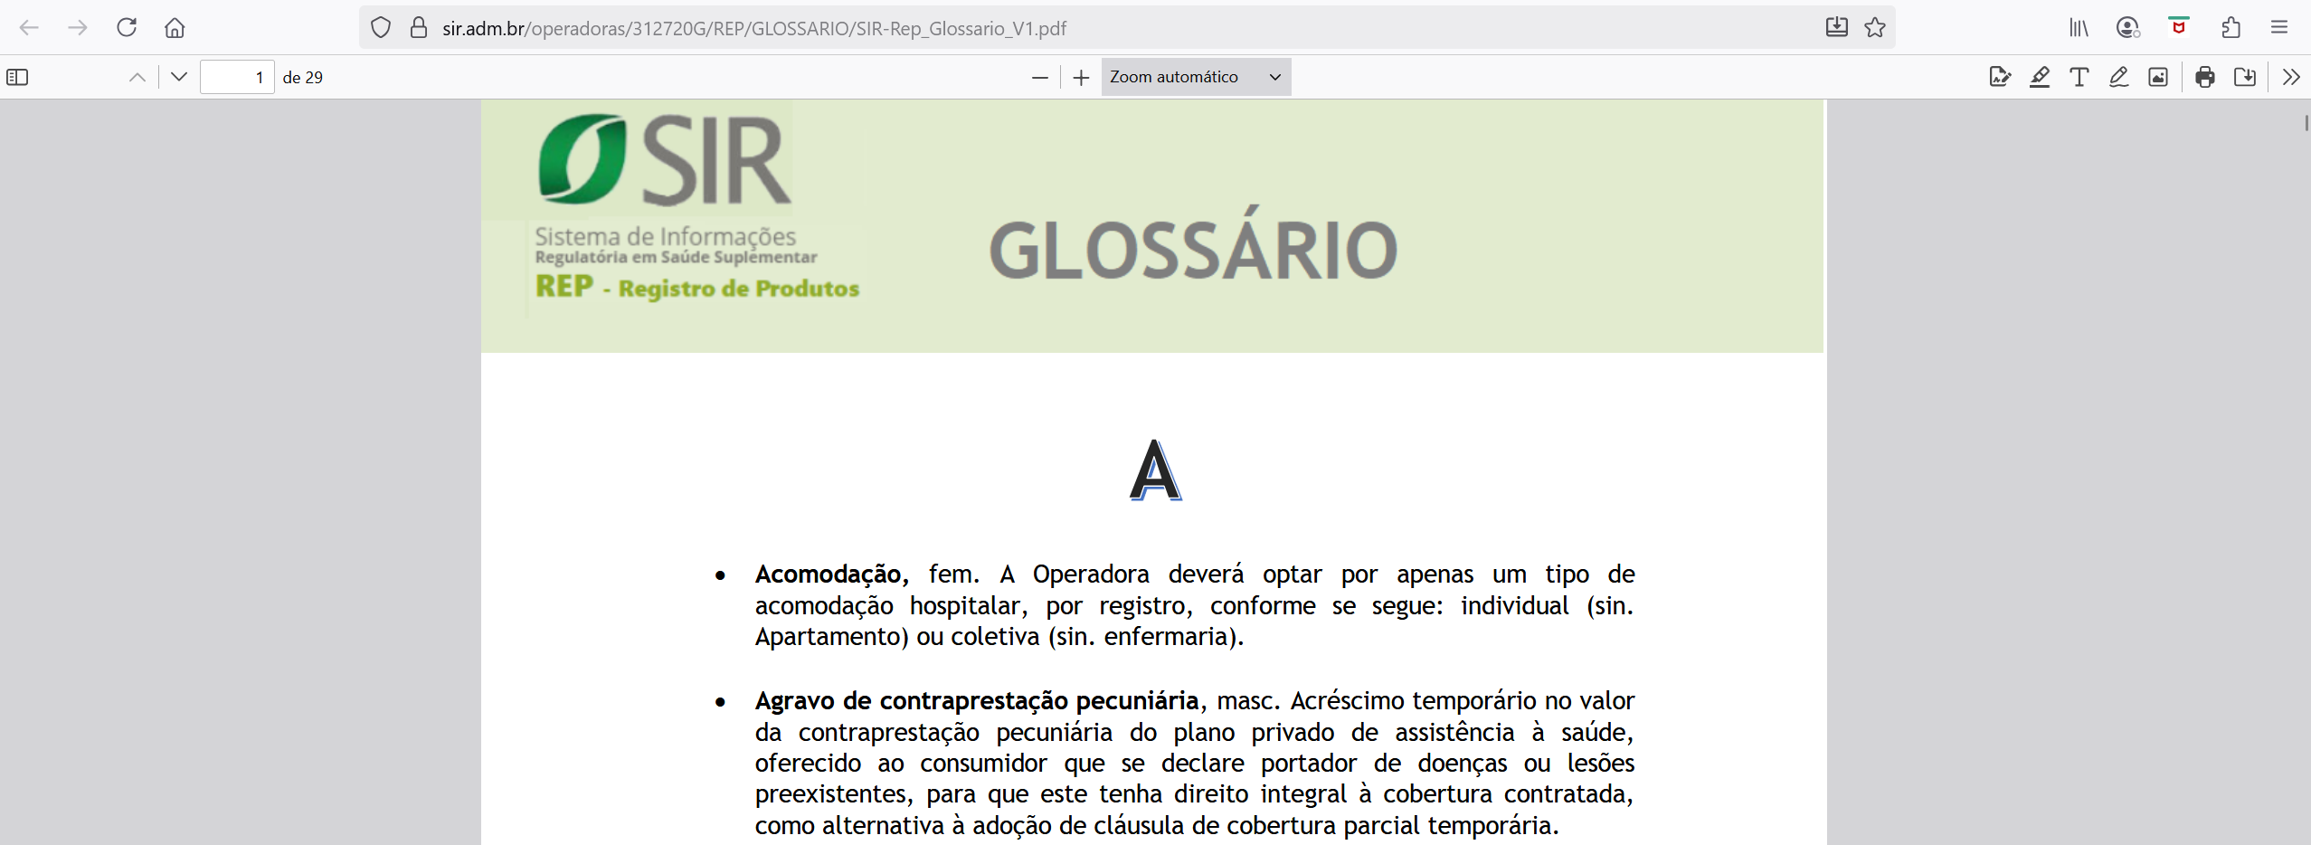
CERPRO – SIR/REP

Slide 9
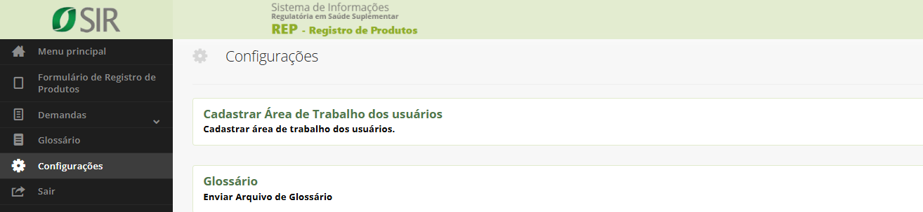
CERPRO – SIR/REP

Slide 10
Ives Tomita
ives@sir.adm.br
www.sir.adm.br

